Slide 1


Iryna Rakhuba
12.03.2025

Slide 2

Outline
Executive Summary
Introduction
Methodology
Results
Conclusion
Appendix

Slide 3
Executive Summary
Summary of methodologies
Data were collected using the SpaceX REST API.
An Exploratory Data Analysis (EDA) was performed to find some patterns in the data and determine what would be the label for training supervised models.
The interactive visual analytics were performed using Folium and Plotly.
The data analysed with SVM, Classification tree and Logistic Regression methods.
Summary of all results
A correlation was found between Launch Site and Flight Number, Payload mass, Orbit type. It was also figured out that success rate since 2013 kept increasing till 2020.

Slide 4
Introduction
SpaceX advertises Falcon 9 rocket launches on its website with a cost of 62 million dollars; other providers cost upward of 165 million dollars each, much of the savings is because SpaceX can reuse the first stage.
We will predict if the Falcon 9 first stage will land successfully.Therefore if we can determine if the first stage will land, we can determine the cost of a launch. This information can be used if an alternate company wants to bid against SpaceX for a rocket launch.

Slide 5

Section 1

Slide 6
Methodology
Executive Summary
Data collection methodology:
Data were collected using the SpaceX REST API.
WEb scraping was performed to collect Falcon 9 historical launch records from a Wikipedia page “List of Falcon 9 and Falcon heavy launches”
Perform data wrangling
Missing values were replaced with the mean.
Perform exploratory data analysis (EDA) using visualization and SQL
Perform interactive visual analytics using Folium and Plotly Dash
Perform predictive analysis using classification models
SVM, Classification tree and Logistic Regression classification models were used for predictive analysis

Slide 7
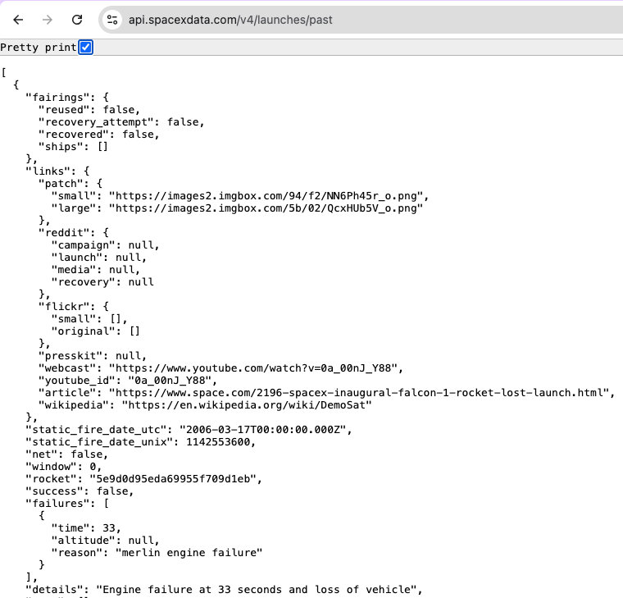
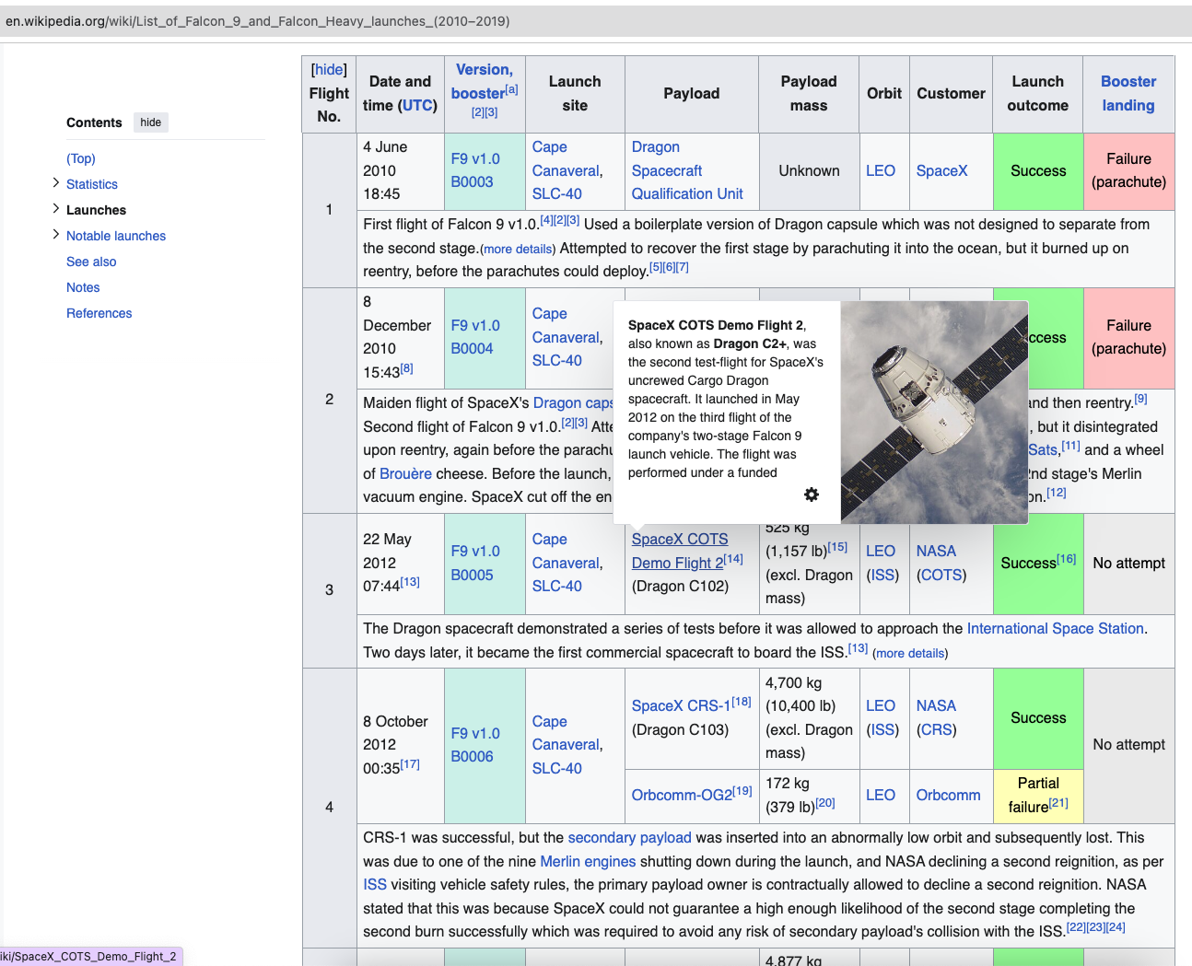
Data Collection
Data sets were collected from two sources: SpaceX API and Wiki Pages.

Slide 8
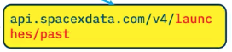
Data Collection – SpaceX API
spacex_url="https://api.spacexdata.com/v4/launches/past"
response = requests.get(spacex_url)
response.status_code
data_j = response.json()
data = pd.json_normalize(data_j)
data = data[['rocket', 'payloads', 'launchpad', 'cores', 'flight_number', 'date_utc']]
data = data[data['cores'].map(len)==1]
data = data[data['payloads'].map(len)==1]
data['cores'] = data['cores'].map(lambda x : x[0])
data['payloads'] = data['payloads'].map(lambda x : x[0])
data['date'] = pd.to_datetime(data['date_utc']).dt.date
data = data[data['date'] <= datetime.date(2020, 11, 13)]
The SpaceX REST API provides data on launches, including rocket details, payloads, and landing outcomes. The base URL is api.spacexdata.com/v4/, with specific endpoints like /launches/past.
Data Retrieval: perform a GET request using the requests library to obtain past launch data, which will be returned in JSON format.
Data Normalization: the JSON data will be converted into a Pandas DataFrame using the json_normalize function for easier analysis.
https://github.com/WagabundaKr/SpaceX/blob/3d1fd8214cbd7a24f4d0ab814ff6c9ca6caff1b1/1_jupyter-labs-spacex-data-collection-api.ipynb

Slide 9
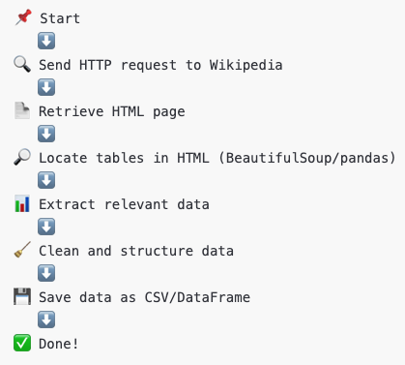
Data Collection - Scraping
Key Steps of Web Scraping
Send Request → Use requests to get the HTML page.
Parse HTML → Use BeautifulSoup to extract relevant data.
Extract Tables → Use pandas.read_html() to retrieve tables.
Clean and Transform Data → Convert it into a structured format.
Save Data → Store it in CSV or a DataFrame.
https://github.com/WagabundaKr/SpaceX/blob/3d1fd8214cbd7a24f4d0ab814ff6c9ca6caff1b1/2_jupyter-labs-webscraping.ipynb

Slide 10
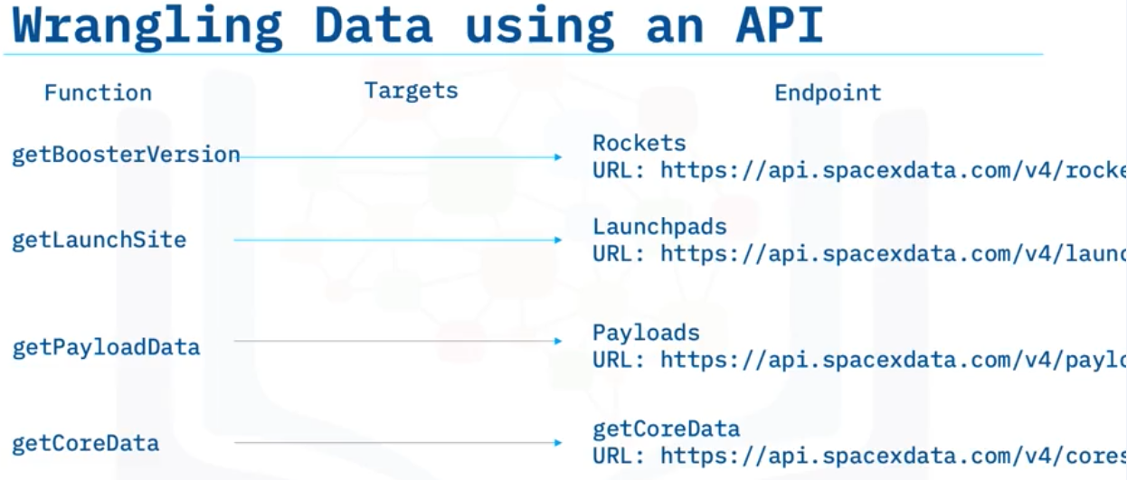
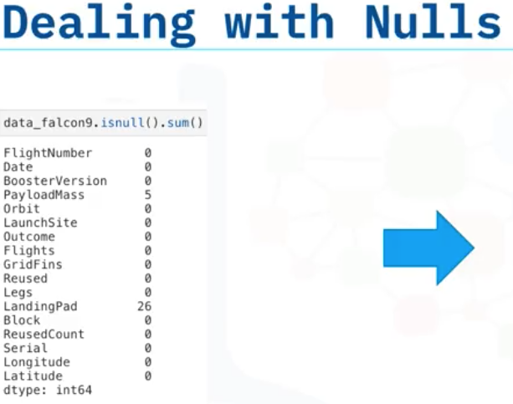
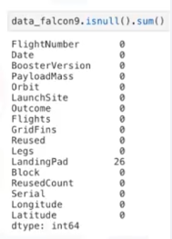

Data Wrangling
https://github.com/WagabundaKr/SpaceX/blob/3d1fd8214cbd7a24f4d0ab814ff6c9ca6caff1b1/3_labs-jupyter-spacex-Data%20wrangling.ipynb

Slide 11
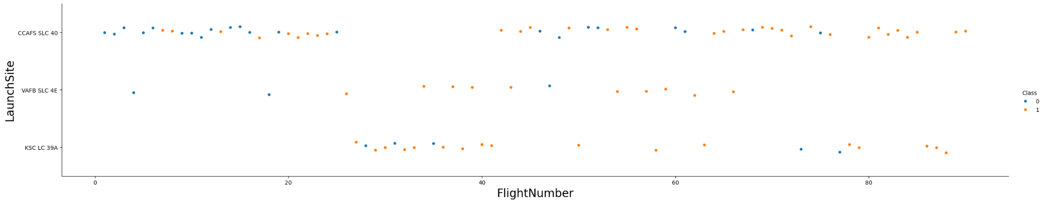
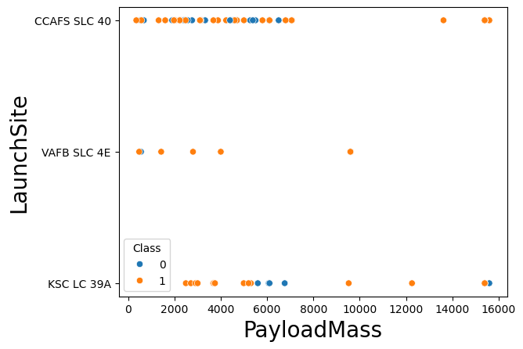
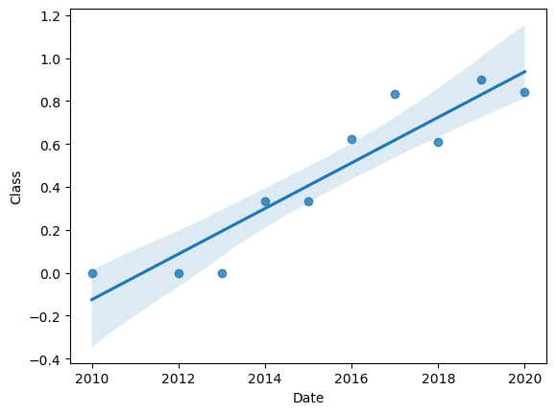
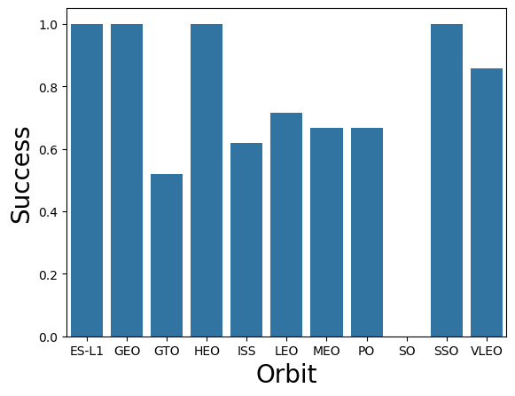
EDA with Data Visualization
https://github.com/WagabundaKr/SpaceX/blob/3d1fd8214cbd7a24f4d0ab814ff6c9ca6caff1b1/5_edadataviz.ipynb

Slide 12
EDA with SQL
%sql SELECT DISTINCT Launch_Site FROM SPACEXTABLE
%sql SELECT * FROM SPACEXTABLE WHERE Launch_Site LIKE '%CCA%' LIMIT 5
%sql SELECT SUM(PAYLOAD_MASS__KG_) FROM SPACEXTABLE
%sql SELECT AVG(PAYLOAD_MASS__KG_) FROM SPACEXTABLE WHERE Booster_Version LIKE '%F9 v1.1%'
%sql select MIN(Date) from SPACEXTABLE where Landing_Outcome = 'Success (ground pad)'
%sql select Booster_Version from SPACEXTABLE where Landing_Outcome = 'Success (drone ship)' and PAYLOAD_MASS__KG_ between 4000 and 6000
%sql select COUNT(Mission_Outcome) from SPACEXTABLE
%sql select Booster_Version, PAYLOAD_MASS__KG_ from SPACEXTABLE where PAYLOAD_MASS__KG_=(select MAX(PAYLOAD_MASS__KG_)from SPACEXTABLE)
%sql SELECT substr(Date, 6,2) as Month, Landing_Outcome, Booster_Version, Launch_Site from SPACEXTABLE where Landing_Outcome='Failure (drone ship)' and substr(Date,0,5)='2015'
%sql select Landing_Outcome, Date, COUNT(*) as Landing_Outcome_count from SPACEXTABLE where Date between '2010-06-04' and '2017-03-20' GROUP BY Landing_Outcome ORDER BY Landing_Outcome_count DESC
https://github.com/WagabundaKr/SpaceX/blob/3d1fd8214cbd7a24f4d0ab814ff6c9ca6caff1b1/4_jupyter-labs-eda-sql-coursera_sqllite.ipynb

Slide 13
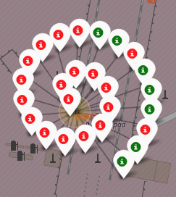
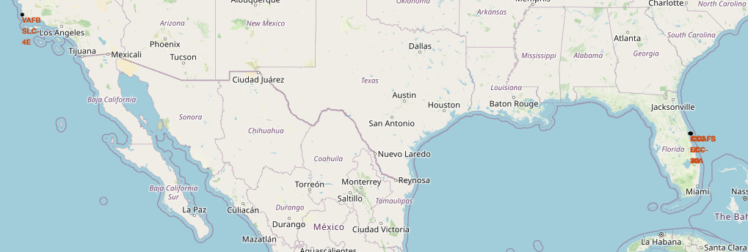
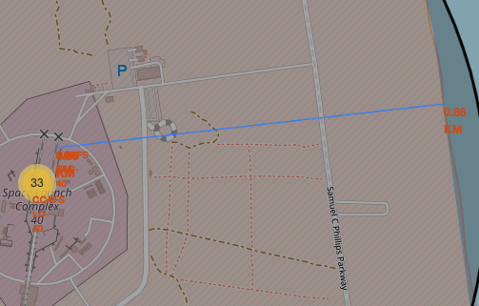
Build an Interactive Map with Folium
All launch sites were marked on a map → folium.Circle(), folium.Marker()
The success/failed launches for each site were marked on the map → folium.Marker(), MarkerCluster()
The distances between a launch site to its proximities were calculated → MousePosition(), folium.PolyLine()
https://github.com/WagabundaKr/SpaceX/blob/3d1fd8214cbd7a24f4d0ab814ff6c9ca6caff1b1/6_lab_jupyter_launch_site_location_folium.ipynb

Slide 14
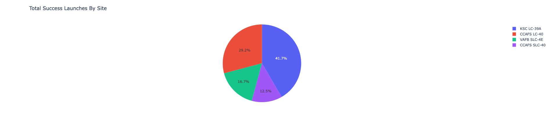
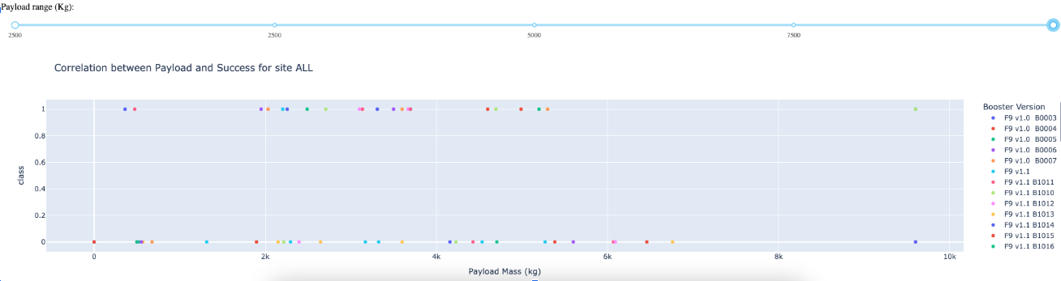
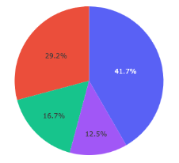
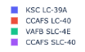
Build a Dashboard with Plotly Dash
Dashboard allows analyze launch records interactively.
It’s possible examine success launches by site and visualize correlation between payload mass and success of launches.
https://github.com/WagabundaKr/SpaceX/blob/3d1fd8214cbd7a24f4d0ab814ff6c9ca6caff1b1/7_spacex_dash_app.py

Slide 15
Predictive Analysis (Classification)
Classification model:
Building / Improving
determine training labels → to_numpy()
standardize the data → preprocessing.StandardScaler()
split into training data and test data → train_test_split()
Find best Hyperparameter GridSearchCV() for
SVM → SVC()
Classification Trees → DecisionTreeClassifier()
Logistic Regression → LogisticRegression()
↓
Evaluating
calculate the accuracy → score(), classification_report()
↓
Selecting of the best model
comparison of confusions matrixes → plot_confusion_matrix()
https://github.com/WagabundaKr/SpaceX/blob/3d1fd8214cbd7a24f4d0ab814ff6c9ca6caff1b1/8_SpaceX_Machine%20Learning%20Prediction_Part_5.ipynb

Slide 16
Results
Exploratory data analysis shows that success rate can be affected by next features:
FlightNumber,
PayloadMass,
Orbit,
LaunchSite,
Year.
Interactive analytics demo in screenshots
KSC LC-39A has the highest success rate (41.7%), making it the most reliable launch site.
CCAFS LC-40 follows with 29.2% of successful launches.
VAFB SLC-4E and CCAFS SLC-40 have lower success percentages (16.7% and 12.5%).
The dashboard allows filtering by launch site, helping analyze performance trends individually.
Predictive analysis results
All 4 model demonstrate the same confusion matrix.
Each of them can distinguish between the different classes.

Slide 17

Section 2

Slide 18
Flight Number vs. Launch Site
Observing the Patterns in the Scatter Plot:
Success vs. Failure Distribution
The plot shows the relationship between Flight Number and Launch Site, with color representing mission success (1 - orange) and failure (0 - blue).
Over time (higher Flight Number), the success rate appears to improve, as there are more orange dots towards the right
Launch Site Comparison
CCAFS SLC 40 has the highest number of launches, with a mix of successes and failures.
VAFB SLC 4E has fewer launches, with failures in early launches but more successes later.
KSC LC 39A has a noticeable trend of increasing success after initial failures.
General Trend
Early flights had more failures, suggesting an improvement in reliability over time.
Each launch site shows a learning curve, with failures initially and more successful launches as experience increases.
This suggests that SpaceX improved its launch technology and operations over time, increasing the likelihood of success as they gained experience with more flights. 🚀

Slide 19
Payload vs. Launch Site
Observing the Patterns in the Scatter Plot:
Success vs. Failure by Payload Mass
The plot shows the relationship between Payload Mass and Launch Site, with color representing mission success (1 - orange) and failure (0 - blue).
Higher payloads tend to have more successful launches, especially above 10,000 kg.
Launch Site Comparison
CCAFS SLC 40 has a wide range of payloads, with both successes and failures, but failures seem more common for medium-range payloads (4000-6000 kg).
VAFB SLC 4E shows fewer launches overall, but most seem successful, especially for lower payloads (<6000 kg).
KSC LC 39A has fewer failures for payloads up to 4000 kg, but failures appear at higher payloads (~6000 kg and above).
General Trends
Lighter payloads (0-4000 kg): High success rates across all launch sites.
Medium payloads (4000-6000 kg): More failures, particularly at CCAFS SLC 40 and KSC LC 39A.
Heavy payloads (above 10,000 kg): Almost all successful, indicating that SpaceX has optimized launches for very high payloads.
This suggests that mission success is influenced by payload weight, with failures occurring more frequently in the medium payload range but improving significantly for very heavy payloads. 🚀

Slide 20
Success Rate vs. Orbit Type
Observing the Patterns in the Orbit Success Rate Chart:
High Success Rates for Specific Orbits
ES-L1, GEO, HEO, and SSO have a 100% success rate.
This suggests that missions targeting these orbits are well-optimized and reliable.
Lower Success for GTO (Geostationary Transfer Orbit)
GTO shows the lowest success rate, around 50-60%.
This could be due to the complexity and energy requirements of transferring payloads from GTO to GEO.
Failures may also be related to booster performance or payload deployment issues.
Moderate Success Rates for ISS, LEO, MEO, and PO
ISS, LEO (Low Earth Orbit), MEO (Medium Earth Orbit), and PO (Polar Orbit) have success rates between 60-80%.
LEO and ISS missions likely include cargo resupply and satellite deployments, which have seen some failures but mostly stable performance.
MEO and PO might involve navigation and remote sensing satellites, which have higher risks compared to purely low-Earth orbit launches.
VLEO (Very Low Earth Orbit) and SO (Sun-Synchronous Orbit) Perform Well
VLEO has a success rate above 80%, which is a good indicator for small satellite and reconnaissance missions.
SSO (Sun-Synchronous Orbit) reaches 100%, showing strong reliability for Earth observation and scientific missions.
Insights & Implications:
SpaceX has mastered missions to GEO, HEO, SSO, and ES-L1.
GTO is the riskiest orbit in this dataset.
ISS and LEO have moderate risks, likely due to payload complexities.
The overall trend suggests higher-altitude orbits (SSO, GEO, HEO) tend to have better success rates compared to lower-altitude orbits like LEO, MEO, and GTO.
🚀 Conclusion: SpaceX's launch success varies by orbit, with GTO being the most challenging, while GEO, SSO, and deep space missions show strong reliability.

Slide 21
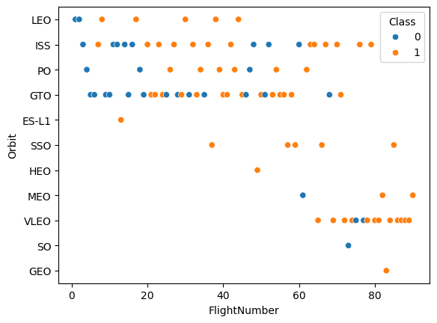
Flight Number vs. Orbit Type
Higher Flight Numbers Show More Success (Class 1 - Orange)
As Flight Number increases, we see a higher concentration of orange dots, indicating that success rates improve over time.
This suggests that SpaceX has improved its landing technology and execution with experience.
Orbit Type Affects Success Rate
LEO (Low Earth Orbit), ISS (International Space Station), and PO (Polar Orbit) have a mix of both successes (orange) and failures (blue).
GTO (Geostationary Transfer Orbit) has more failures, possibly due to the increased difficulty of reaching this orbit.
VLEO (Very Low Earth Orbit) and SO (Solar Orbit) show a higher percentage of successful landings.
More Frequent Launches to Certain Orbits
The densest areas of the scatter plot are in LEO, ISS, PO, and GTO, indicating that most missions target these orbits.
Other orbits (ES-L1, SO, GEO) have fewer data points, meaning SpaceX attempts them less frequently.
Conclusion:
SpaceX has improved its landing success rate over time.
The success rate varies by orbit, with higher success in LEO, ISS, and VLEO and more failures in GTO and HEO.
Frequent mission types (LEO, ISS) benefit from iterative learning, leading to better landing performance.

Slide 22
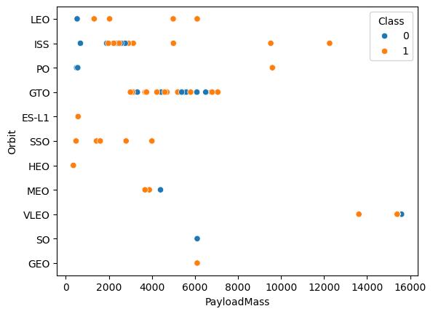
Payload vs. Orbit Type
Higher Payload Mass Still Achieves Success
There are successful landings (orange) even for very high payloads (~15,000 kg).
This suggests that SpaceX has improved its ability to land boosters successfully despite carrying heavier payloads.
Orbit Type Influences Success Rate
LEO, ISS, and PO show a high success rate across a range of payload masses.
GTO (Geostationary Transfer Orbit) has a mix of successes and failures, particularly between 4,000–6,000 kg.
HEO (Highly Elliptical Orbit) and SSO (Sun-Synchronous Orbit) have fewer data points, but the pattern suggests moderate success.
Lower Payloads Have Mixed Results
At lower payloads (~0–6,000 kg), there is a mix of both successes (orange) and failures (blue), indicating that mission success at lower payloads was not always guaranteed in earlier flights.
Conclusion:
SpaceX has improved success rates even for heavy payloads.
LEO and ISS missions are more reliable, while GTO and HEO show more failures.
Earlier flights and lighter payloads had more failures, but experience has improved outcomes.

Slide 23
Launch Success Yearly Trend
Steady Increase in Success Rate Over Time
In the early years (2010–2014), most missions resulted in failures (Class close to 0).
As time progresses, the success rate improves, with most missions succeeding after 2016.
By 2019–2020, the majority of missions are successful (Class close to 1).
Regression Line Shows a Strong Positive Trend
The best-fit line indicates a consistent improvement in success rates.
The confidence interval (shaded region) is wider at the beginning (uncertainty in early missions) and narrows as success becomes more predictable.
SpaceX's Learning Curve & Technological Improvements
The increasing success rate aligns with SpaceX’s advancements in Falcon 9 reusability, landing technology, and operational experience.
The failures in early years suggest experimental phases, while later years reflect refined landing techniques.
Conclusion:
SpaceX's success rate has significantly improved over time.
Failures were common in early missions, but after 2015, success became the norm.
The trend suggests that SpaceX's iterative learning approach and technological advancements have led to higher mission reliability.

Slide 24
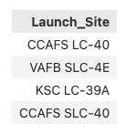
All Launch Site Names
<table>
<thead>
<tr>
<th>Launch_Site</th>
</tr>
</thead>
<tbody>
<tr>
<td>CCAFS LC-40</td>
</tr>
<tr>
<td>VAFB SLC-4E</td>
</tr>
<tr>
<td>KSC LC-39A</td>
</tr>
<tr>
<td>CCAFS SLC-40</td>
</tr>
</tbody>
</table>
SELECT DISTINCT Launch_Site FROM SPACEXTABLE
The DISTINCT keyword in SQL is used to retrieve unique (distinct) values from a column in a table. It helps remove duplicate records from the result set.
It also can be used with multiple columns.
DISTINCT applies to all selected columns, meaning the entire row must be unique to be included in the results.
It can be slow on large datasets because it requires sorting and filtering.
It does not modify the actual table data; it only affects the query results.

Slide 25
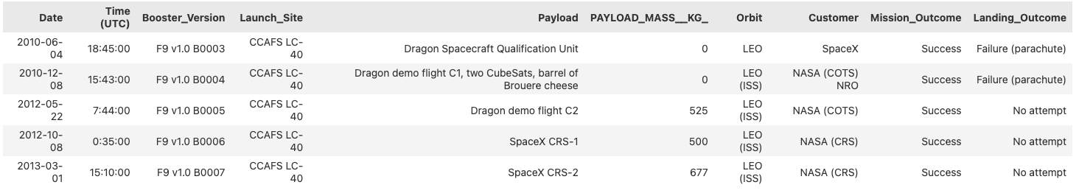
Launch Site Names Begin with 'CCA'
SELECT * FROM SPACEXTABLE WHERE Launch_Site LIKE '%CCA%' LIMIT 5
The LIKE operator is used in SQL to search for a specific pattern within a column, usually with text values.
% (percent sign): Matches zero, one, or multiple characters.
_ (underscore): Matches exactly one character.
The LIMIT clause restricts the number of rows returned in a query result.

Slide 26
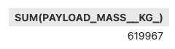
Total Payload Mass
SELECT SUM(PAYLOAD_MASS__KG_) FROM SPACEXTABLE
The SUM aggregate function in SQL is used to calculate the total sum of a numeric column.
✅ SUM works only on numeric columns.
✅ It ignores NULL values in the column.
✅ Often used with GROUP BY to summarize data
The other aggregate function are AVG, MAX, MIN, and COUNT.

Slide 27
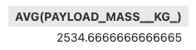
Average Payload Mass by F9 v1.1
SELECT AVG(PAYLOAD_MASS__KG_)
FROM SPACEXTABLE
WHERE Booster_Version LIKE '%F9 v1.1%'
Query Breakdown:
SELECT AVG(PAYLOAD_MASS__KG_) → Computes the average of the PAYLOAD_MASS__KG_ column.
FROM SPACEXTABLE → Retrieves data from the SPACEXTABLE.
WHERE Booster_Version LIKE '%F9 v1.1%' → Filters only rows where the Booster_Version contains 'F9 v1.1' (due to %, which acts as a wildcard for any characters before or after).

Slide 28
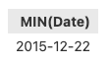
First Successful Ground Landing Date
select MIN(Date) from SPACEXTABLE where Landing_Outcome = 'Success (ground pad)'
This SQL query finds the earliest (minimum) date when a SpaceX rocket successfully landed on a ground pad.
Query Breakdown:
SELECT MIN(Date) → Retrieves the earliest date from the Date column.
FROM SPACEXTABLE → Searches within the SPACEXTABLE.
WHERE Landing_Outcome = 'Success (ground pad)' → Filters only rows where the landing was successful on a ground pad.

Slide 29
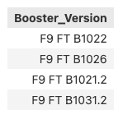
Successful Drone Ship Landing with Payload between 4000 and 6000
select Booster_Version
from SPACEXTABLE
where Landing_Outcome = 'Success (drone ship)'
and PAYLOAD_MASS__KG_ between 4000 and 6000
This SQL query retrieves the booster versions that successfully landed on a drone ship while carrying a payload between 4000 and 6000 kg.
Query Breakdown:
SELECT Booster_Version → Retrieves the booster version used in the launch.
FROM SPACEXTABLE → Searches within the SPACEXTABLE.
WHERE Landing_Outcome = 'Success (drone ship)' → Filters launches that successfully landed on a drone ship.
AND PAYLOAD_MASS__KG_ BETWEEN 4000 AND 6000 → Further filters results to only include launches with a payload mass between 4000 and 6000 kg.

Slide 30
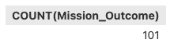
Total Number of Successful and Failure Mission Outcomes
select COUNT(Mission_Outcome) from SPACEXTABLE
This SQL query counts the total number of mission outcomes recorded in the SPACEXTABLE.
Query Breakdown:
SELECT COUNT(Mission_Outcome) → Counts the number of non-null values in the Mission_Outcome column.
FROM SPACEXTABLE → Searches within the SPACEXTABLE.

Slide 31
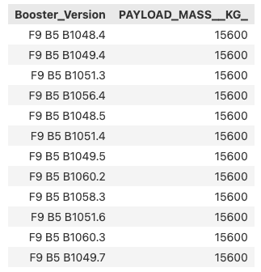
Boosters Carried Maximum Payload
select Booster_Version, PAYLOAD_MASS__KG_
from SPACEXTABLE
where PAYLOAD_MASS__KG_= (select MAX(PAYLOAD_MASS__KG_)
from SPACEXTABLE)
This query retrieves the Booster Version and Payload Mass (in kilograms) from the SPACEXTABLE,
but only for the row where the Payload Mass is the maximum value in the table.
Here’s a breakdown of the query:
Subquery (select MAX(PAYLOAD_MASS__KG_) from SPACEXTABLE):
Finds the maximum value of the PAYLOAD_MASS__KG_ column in the SPACEXTABLE.
Main Query (select Booster_Version, PAYLOAD_MASS__KG_ from SPACEXTABLE where PAYLOAD_MASS__KG_ = ...):
Selects the Booster Version and Payload Mass (kg) from the table where the Payload Mass equals the maximum value found in the subquery.

Slide 32
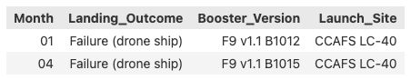
2015 Launch Records
SELECT substr(Date, 6,2) as Month, Landing_Outcome, Booster_Version, Launch_Site
from SPACEXTABLE
where Landing_Outcome='Failure (drone ship)'
and substr(Date,0,5)='2015'
This query retrieves the Month, Landing Outcome, Booster Version, and Launch Site from the SPACEXTABLE for launches that met two specific conditions:
Landing Outcome = 'Failure (drone ship)': The landing failed on a drone ship.
Year = 2015: The launch occurred in the year 2015.
Here’s a breakdown of the query:
substr(Date, 6,2) as Month: Extracts the month (the 6th and 7th characters) from the Date column and labels it as Month.
substr(Date, 0, 5): Extracts the first 4 characters from the Date column, which represents the year, and checks if it's '2015'.
Landing_Outcome = 'Failure (drone ship)': Filters the rows where the landing outcome was a failure on a drone ship.

Slide 33
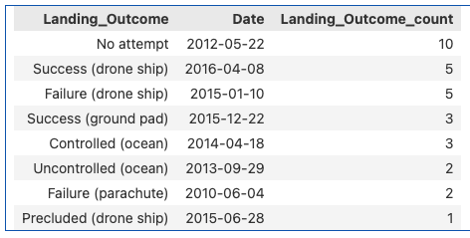
Rank Landing Outcomes Between 2010-06-04 and 2017-03-20
select Landing_Outcome, Date, COUNT(*) as Landing_Outcome_count
from SPACEXTABLE
where Date between '2010-06-04' and '2017-03-20'
GROUP BY Landing_Outcome
ORDER BY Landing_Outcome_count DESC
This query retrieves the Landing Outcome, the Date of the landing,
and the count of each landing outcome from the SPACEXTABLE,
for launches that occurred between June 4, 2010 and March 20, 2017.
Here’s a breakdown of the query:
WHERE Date BETWEEN '2010-06-04' AND '2017-03-20': Filters the rows to include only those with a Date between June 4, 2010, and March 20, 2017.
GROUP BY Landing_Outcome: Groups the results by Landing Outcome, so the query will count the number of occurrences for each landing outcome.
COUNT(*) as Landing_Outcome_count: Counts how many times each Landing Outcome appears in the selected date range.
ORDER BY Landing_Outcome_count DESC: Orders the results by the count of each landing outcome in descending order, showing the most frequent outcomes first.

Slide 34

Section 3

Slide 35
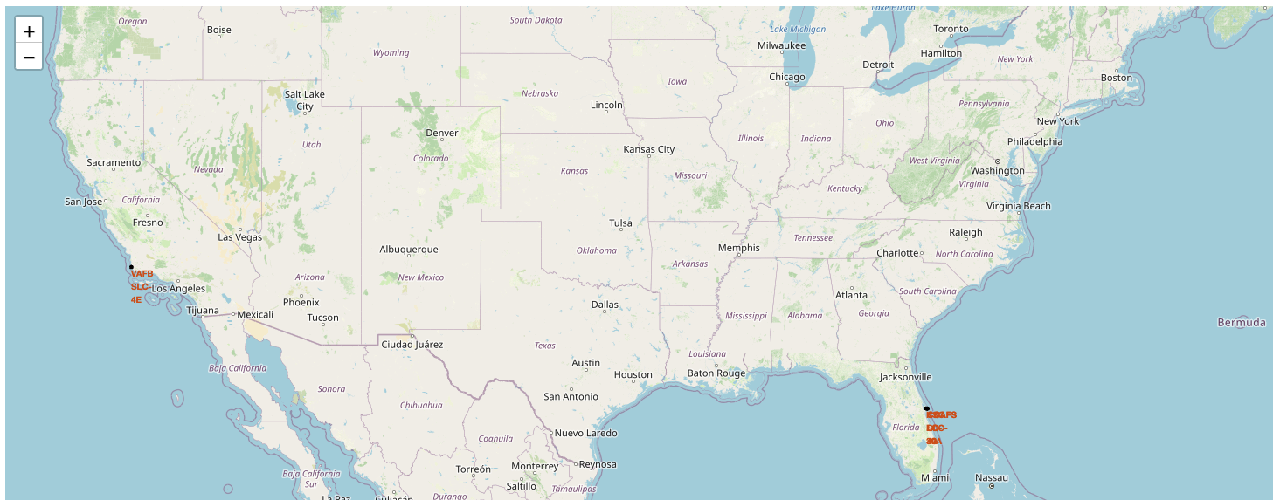
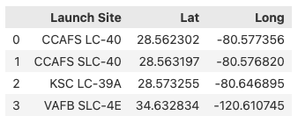
All launch sites on a map
CCAFS LC-40, CCAFS SLC-40 and KSC LC-39A are situated in Florida.
VAFB SLC-4E is situated in California.
While being closer to the Equator is beneficial for launching satellites into geostationary orbit (due to Earth's rotational speed), the U.S. launch sites are still at moderate latitudes.
The Cape Canaveral sites are closer to the Equator (~28° N) than Vandenberg (~34° N), which is much farther north and is mainly used for polar orbits rather than equatorial ones.
All launch sites are located near the coast. The given coordinates show that all sites are within a few kilometers of the ocean.
Coastal locations allow rockets to launch over the ocean, reducing the risk of debris falling on populated areas.
Cape Canaveral (Florida) launches mostly go eastward over the Atlantic Ocean.
Vandenberg (California) launches mainly go southward over the Pacific Ocean, ideal for polar orbits.
Conclusion
✅ Launch sites are not close to the Equator but are in mid-latitudes. ✅ All launch sites are near the coast for safety reasons and optimal launch trajectories.

Slide 36
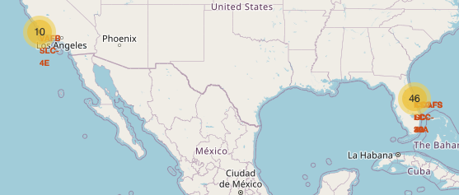
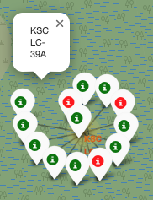
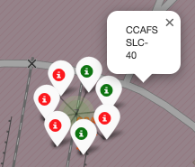
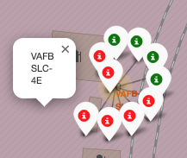
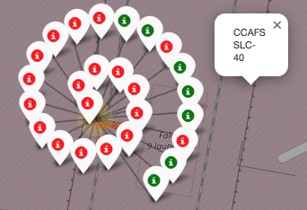
Success / failed launches for each site on the map
From the color-labeled markers in marker clusters, it’s identified that launch site KSC LC-39A has relatively high success rates.

Slide 37
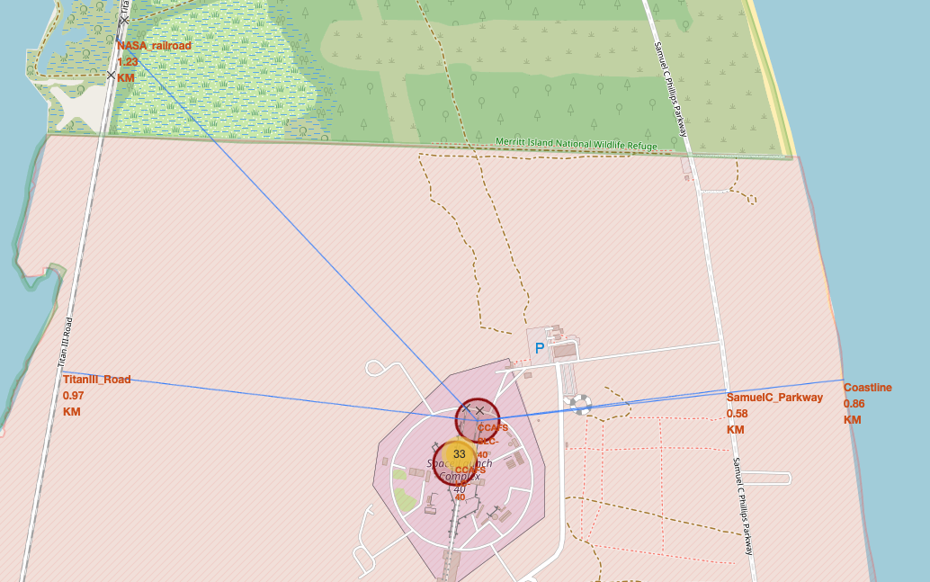
Distance between a launch site to its proximities
NASA Railroad: 1.23 KM (northwest)
Titan III Road: 0.97 KM (southwest)
Samuel C. Parkway: 0.58 KM (east)
Coastline: 0.86 KM (east)
✅ Launch sites are located near the coast for safety reasons, allowing failed rocket stages to fall into the ocean instead of populated areas.
✅ Infrastructure like roads and railroads are present to transport rocket components and fuel.
✅ The restricted zone (shaded area) ensures no unauthorized personnel are close to the launch pad during operations.

Slide 38

Section 4

Slide 39
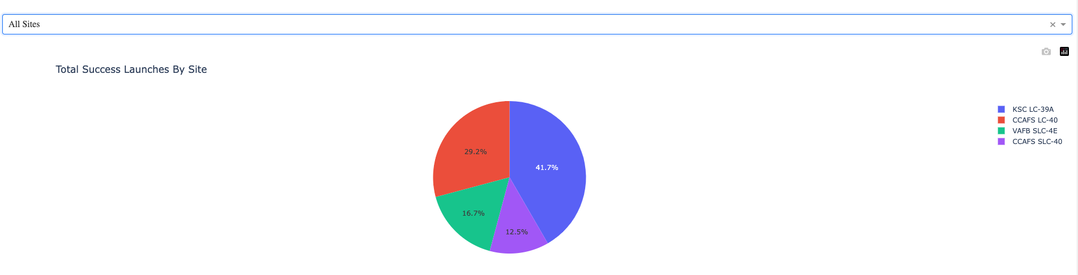
SpaceX Launch Records Dashboard
✅ KSC LC-39A has the highest success rate (41.7%), making it the most reliable launch site.
✅ CCAFS LC-40 follows with 29.2% of successful launches.
✅ VAFB SLC-4E and CCAFS SLC-40 have lower success percentages (16.7% and 12.5%).
✅ The dashboard allows filtering by launch site, helping analyze performance trends individually.

Slide 40
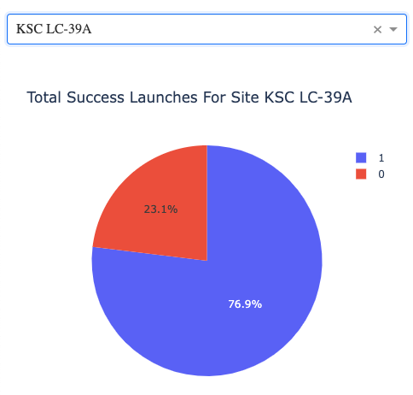
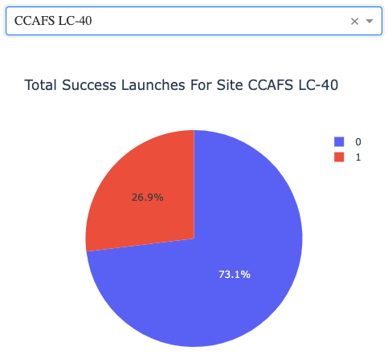
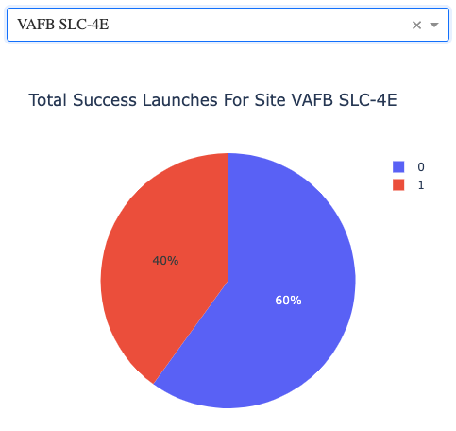
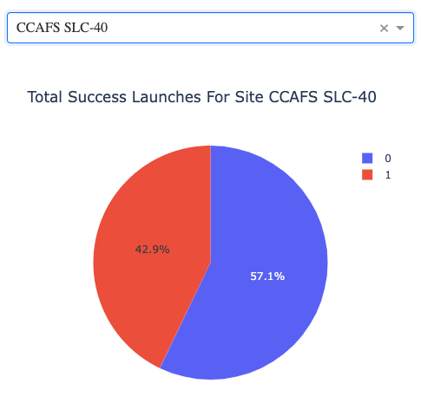
Launch site with highest launch success ratio
✅ KSC LC-39A has a high success rate (76.9%), making it a reliable launch site.
✅ Failure rate is 23.1%, indicating some unsuccessful launches but overall strong performance.
✅ The filtering function allows analyzing specific sites separately, which is useful for trend evaluation.
Blue (1) → Successful launches
Red (0) → Unsuccessful launches

Slide 41
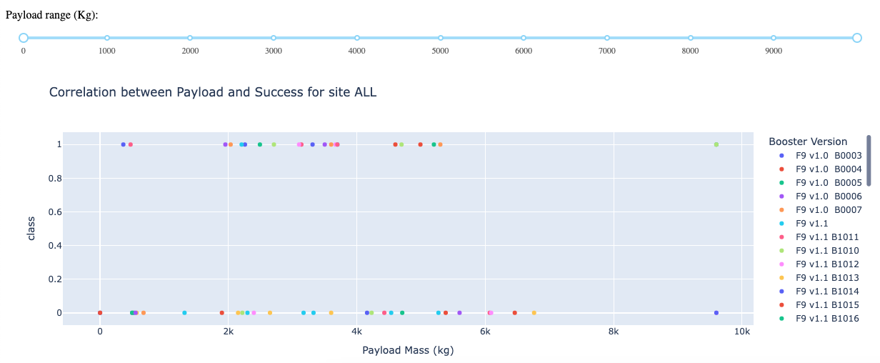
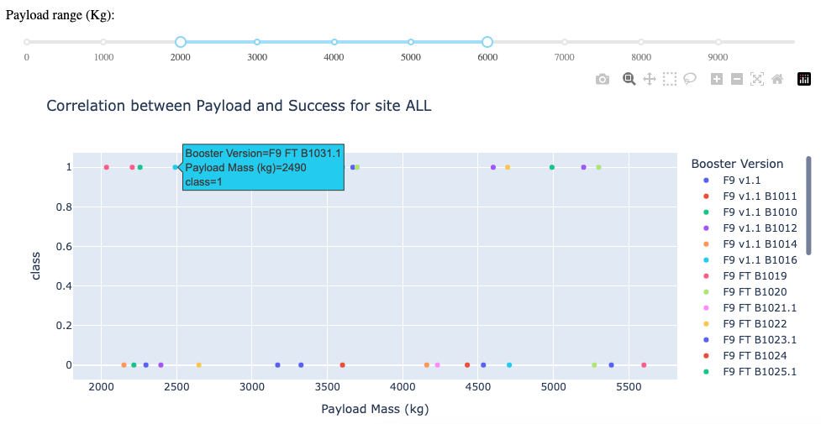
Payload vs. Launch Outcome scatter plot for all sites
✅ Payload range 3000-4000 kg has the highest launch success rate.
✅ Payload range 6000-7000 kg
has the lowest launch success rate
✅ Booster versions FT and B5 have the highest
launch success rate 65% and 100%, respectively.
But B5 has only 1 launch.
At the same time FT has 23 launches (15:8)

Slide 42

Section 5

Slide 43
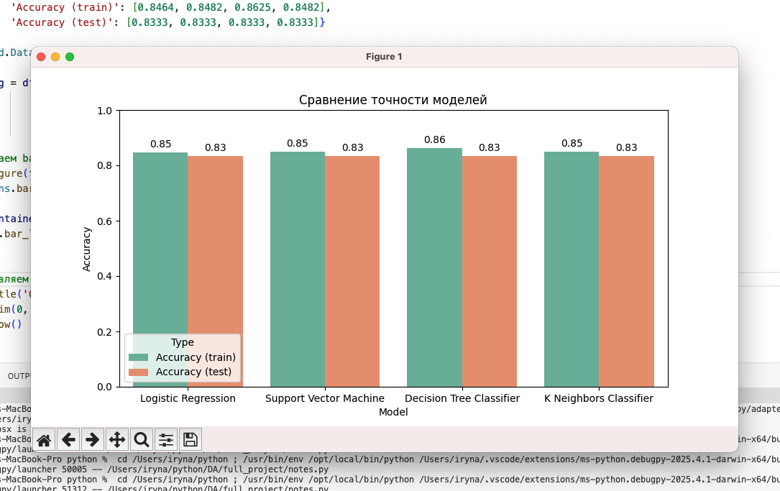
Classification Accuracy
The Decision Tree Classifier has the highest training accuracy of 0.86.
However, all models have the same test accuracy of 0.83.
This may be due to the small size of the data set.
If the goal is to minimize overfitting and maintain a balance, Logistic Regression or Support Vector Machine might be better choices.
If higher training accuracy is prioritized, Decision Tree Classifier would be the best.

Slide 44
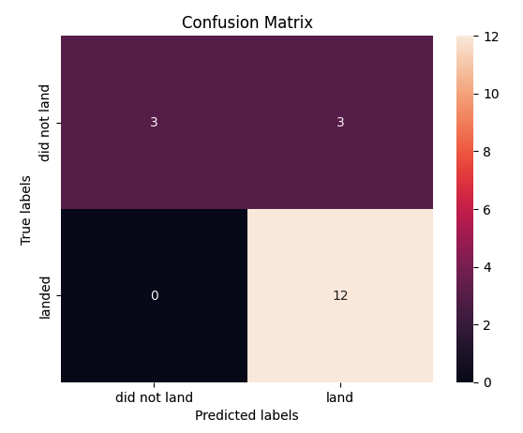
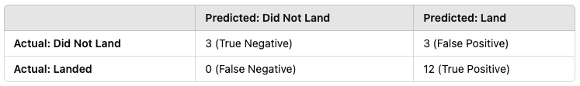
Confusion Matrix
All 4 model demonstrate the same confusion matrix.
Each of them can distinguish between the different classes.
Key Observations:
True Positives (TP) = 12 → The model correctly predicted 12 landings.
True Negatives (TN) = 3 → The model correctly identified 3 non-landings.
False Positives (FP) = 3 → The model mistakenly predicted landing when it didn’t happen.
False Negatives (FN) = 0 → The model never misclassified a landed rocket as not landed.

Slide 45
Conclusions
The three most important reasons why different models show the same accuracy on a test dataset are:
1. Limited Variability in the Test Set
If the test dataset is small or lacks diversity, different models may make the same predictions, leading to identical accuracy.
2. Dominant Features Driving Predictions
If one or two features strongly influence the outcome, all models may rely on them, making similar predictions despite using different algorithms.
3. Identical Decision Boundaries
If the dataset is simple or well-structured, different models may learn nearly the same decision boundary, resulting in the same test accuracy.
Performance Insights:
The model has zero false negatives, meaning it never misses an actual landing.
There are 3 false positives, indicating that in some cases, the model wrongly predicted a landing when it didn’t happen.
The overall performance seems strong in identifying successful landings, but it has some misclassifications in predicting non-landings.

Slide 46
Appendix
https://github.com/WagabundaKr/SpaceX/blob/3d1fd8214cbd7a24f4d0ab814ff6c9ca6caff1b1/dataset_part1.csv
https://github.com/WagabundaKr/SpaceX/blob/3d1fd8214cbd7a24f4d0ab814ff6c9ca6caff1b1/dataset_part_2.csv
https://github.com/WagabundaKr/SpaceX/blob/3d1fd8214cbd7a24f4d0ab814ff6c9ca6caff1b1/dataset_part__3.csv
https://github.com/WagabundaKr/SpaceX/blob/3d1fd8214cbd7a24f4d0ab814ff6c9ca6caff1b1/spacex_launch_dash.csv
https://github.com/WagabundaKr/SpaceX/blob/3d1fd8214cbd7a24f4d0ab814ff6c9ca6caff1b1/spacex_web_scraped.csv

Slide 47


